Slide 1
Disaster Tweet Classification using Classical NLP
Author: Sukanya Naik

Slide 2
📌 Project Overview
This project explores disaster tweet classification using classical Natural Language Processing (NLP) and machine learning techniques. The objective is to classify whether a tweet is related to a real disaster event or not based on its textual content.
The project was built using the Kaggle Natural Language Processing with Disaster Tweets dataset and focuses on creating an interpretable end-to-end NLP workflow using traditional machine learning approaches.
The workflow includes:
Exploratory Data Analysis (EDA)
Text preprocessing and cleaning
TF-IDF feature engineering
Baseline model comparison
Hyperparameter tuning
Model interpretation
Error analysis
Final Model submission generation

Slide 3
🎯 Business Problem
Social media platforms often become one of the fastest sources of information during natural disasters, emergencies, and crisis events. However, large volumes of noisy and informal text make it difficult to identify genuinely important content in real time.
This project demonstrates how machine learning can be used to automatically classify disaster-related tweets to support:
Emergency response monitoring
Crisis detection systems
Social media intelligence pipelines
Public safety analytics
Early-stage alert systems

Slide 4
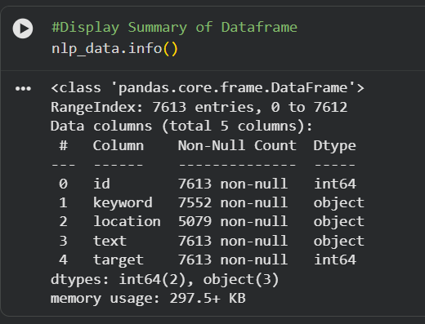
📂 Dataset Information
Dataset Source: twitter_disaster.xlsx
Training Dataset
Rows: 7,613
Columns: 5
Target Classes:
  0 → Non-disaster tweet
  1 → Disaster-related tweet
Dataset Characteristics
Moderately balanced target distribution
Informal social media language
Contains hashtags, mentions, URLs, abbreviations, and slang
Includes noisy and context-dependent text patterns

Slide 5
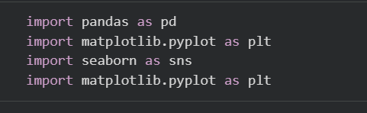
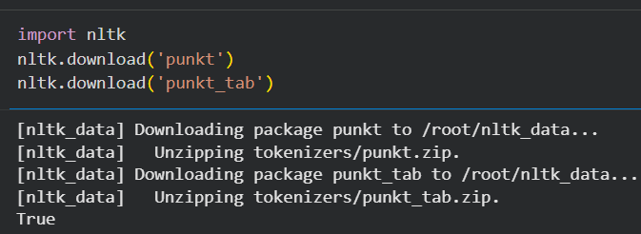
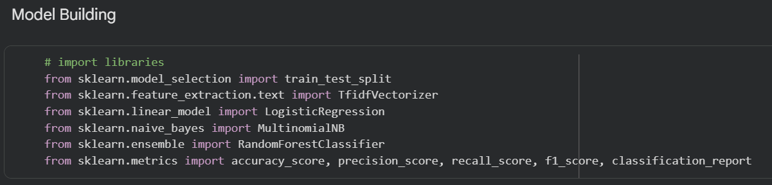
🛠️ Technologies Used
Programming Language :
Python
Libraries:
pandas
numpy
matplotlib
seaborn
nltk
scikit-learn
Machine Learning Techniques:
TF-IDF Vectorization
Multinomial Naive Bayes
Logistic Regression
GridSearchCV Hyperparameter Tuning

Slide 6
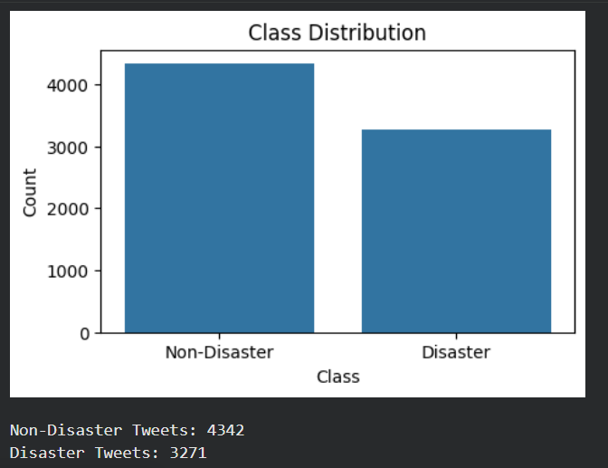
📊 Exploratory Data Analysis
The exploratory analysis revealed several useful patterns:
  Disaster-related tweets were generally longer on average.
  Tweet text contained significant noise such as hashtags, mentions, and URLs.
  Disaster keywords such as wildfire, earthquake, and flood appeared frequently in positive samples.
  The dataset contained both literal and figurative disaster-related language.

Slide 7
🧹 Text Preprocessing
The text preprocessing pipeline included:
Lowercasing text
Removing URLs
Removing user mentions
Removing punctuation and numbers
Tokenization
Stopword removal
Porter stemming
Example transformation:
Original Text | Cleaned Text
Forest fire near La Ronge Sask. Canada | forest fire near rong sask canada
13,000 people receive #wildfires evacuation orders in California | peopl receiv wildfir evacu order california

Slide 8
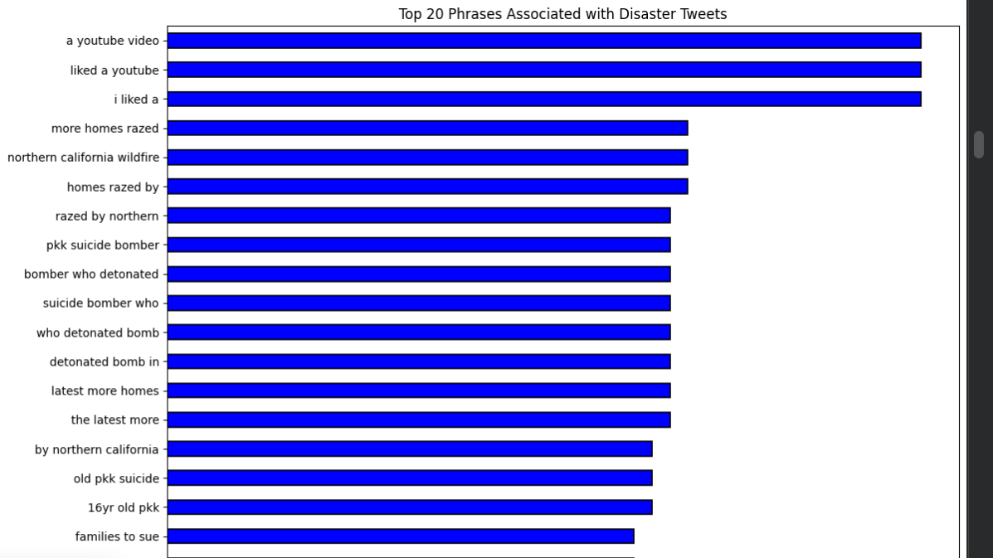
🤖 Model Interpretation

Slide 9
⚠️ Error Analysis
The error analysis revealed several common NLP limitations:
  Figurative language and sarcasm confused the model.
  Some tweets used disaster-related words in non-disaster contexts.
  Context-dependent tweets remained difficult to classify correctly.
  Traditional NLP models struggled with semantic understanding.
These observations highlight why more advanced transformer-based NLP models may outperform classical approaches in production environments.

Slide 10
📌 Final Conclusion
This project demonstrates how classical NLP and machine learning techniques can still provide strong baseline performance for text classification tasks.
Beyond model training, the project also emphasizes:
interpretable machine learning
evaluation trade-off analysis
practical NLP preprocessing
model comparison workflows
business-oriented problem framing
Although transformer-based models would likely achieve higher performance, this project highlights the value of lightweight and explainable NLP pipelines that remain computationally efficient and easy to deploy.

Slide 11
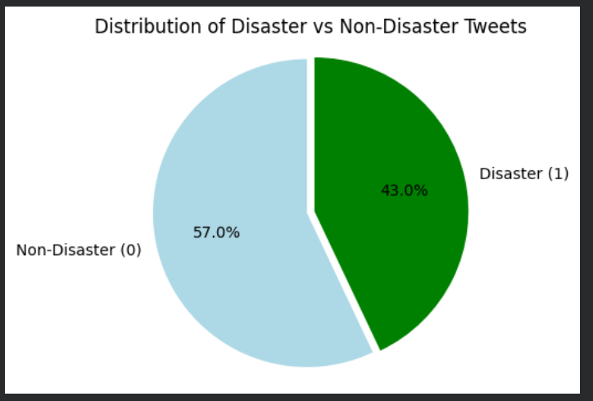
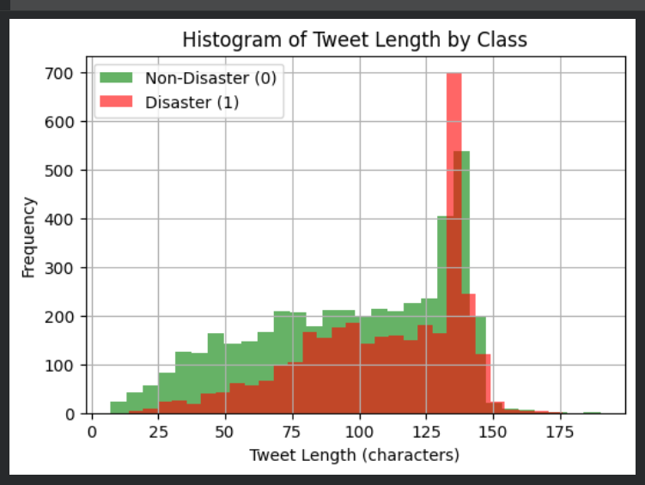
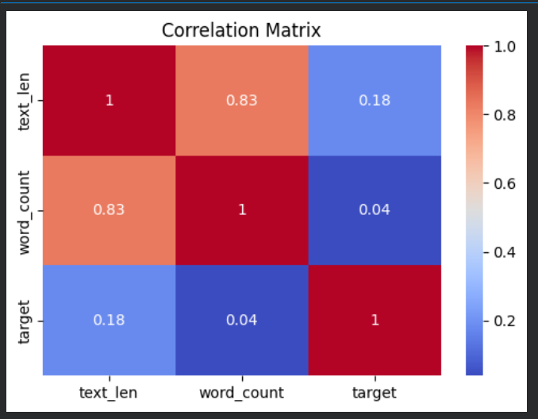
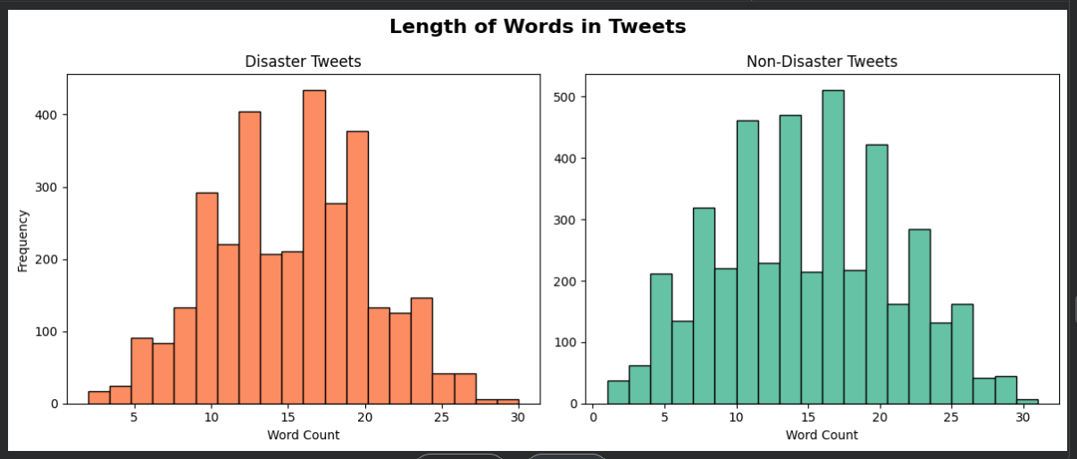
Visualization Graphs

Slide 12
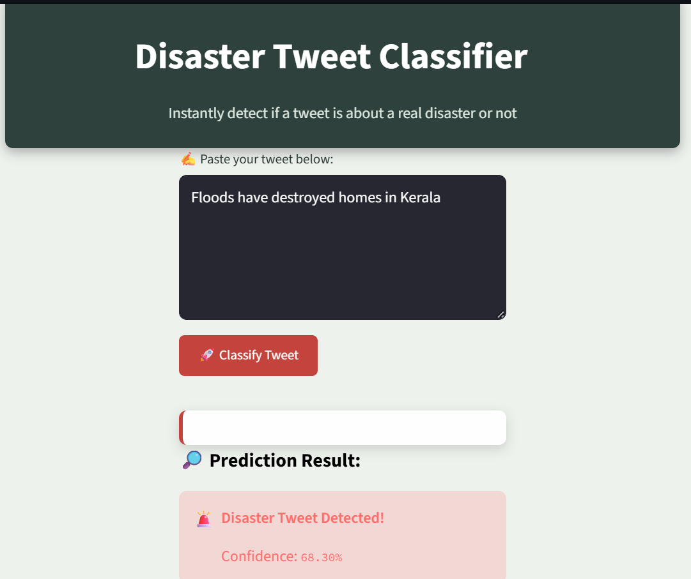
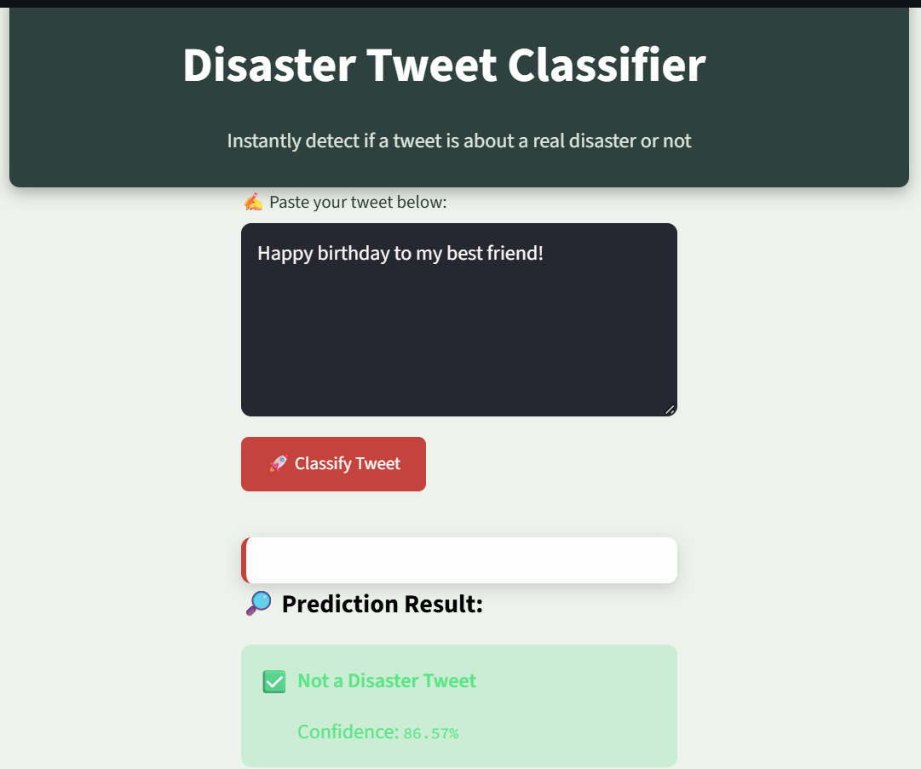
Final Disaster or Non-Disaster Tweet

Slide 13
Thank you

